Slide 1
Graph Representation Learning
William L. Hamilton

Slide 2
Chapter 1: Introduction

Slide 3
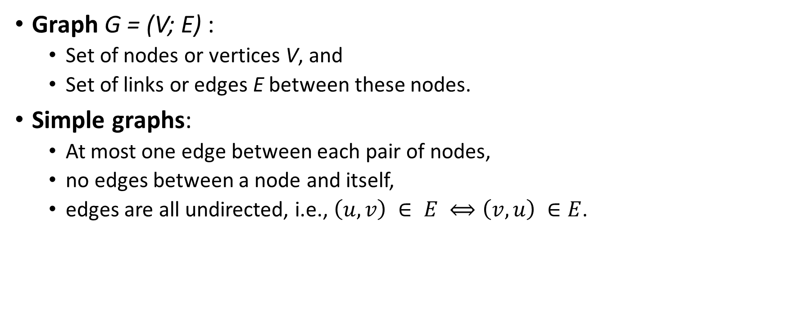
Definitions
Graph G = (V; E) :
Set of nodes or vertices V, and
Set of links or edges E between these nodes.
Simple graphs:
At most one edge between each pair of nodes,
no edges between a node and itself,
edges are all undirected, i.e., $\left(u, v\right) ∈ E ⟺\left(v, u\right) ∈E$.

Slide 4
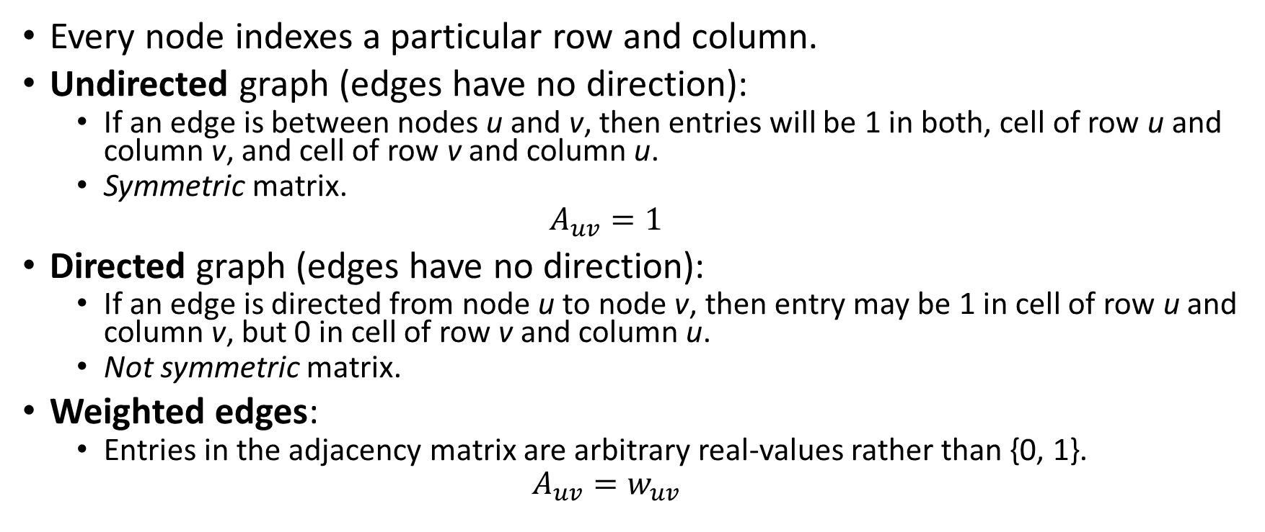
Adjacency matrix
Every node indexes a particular row and column.
Undirected graph (edges have no direction):
If an edge is between nodes u and v, then entries will be 1 in both, cell of row u and column v, and cell of row v and column u.
Symmetric matrix.
$$A_{uv}=1$$
Directed graph (edges have no direction):
If an edge is directed from node u to node v, then entry may be 1 in cell of row u and column v, but 0 in cell of row v and column u.
Not symmetric matrix.
Weighted edges:
Entries in the adjacency matrix are arbitrary real-values rather than {0, 1}.
$$A_{uv}=w_{uv}$$

Slide 5
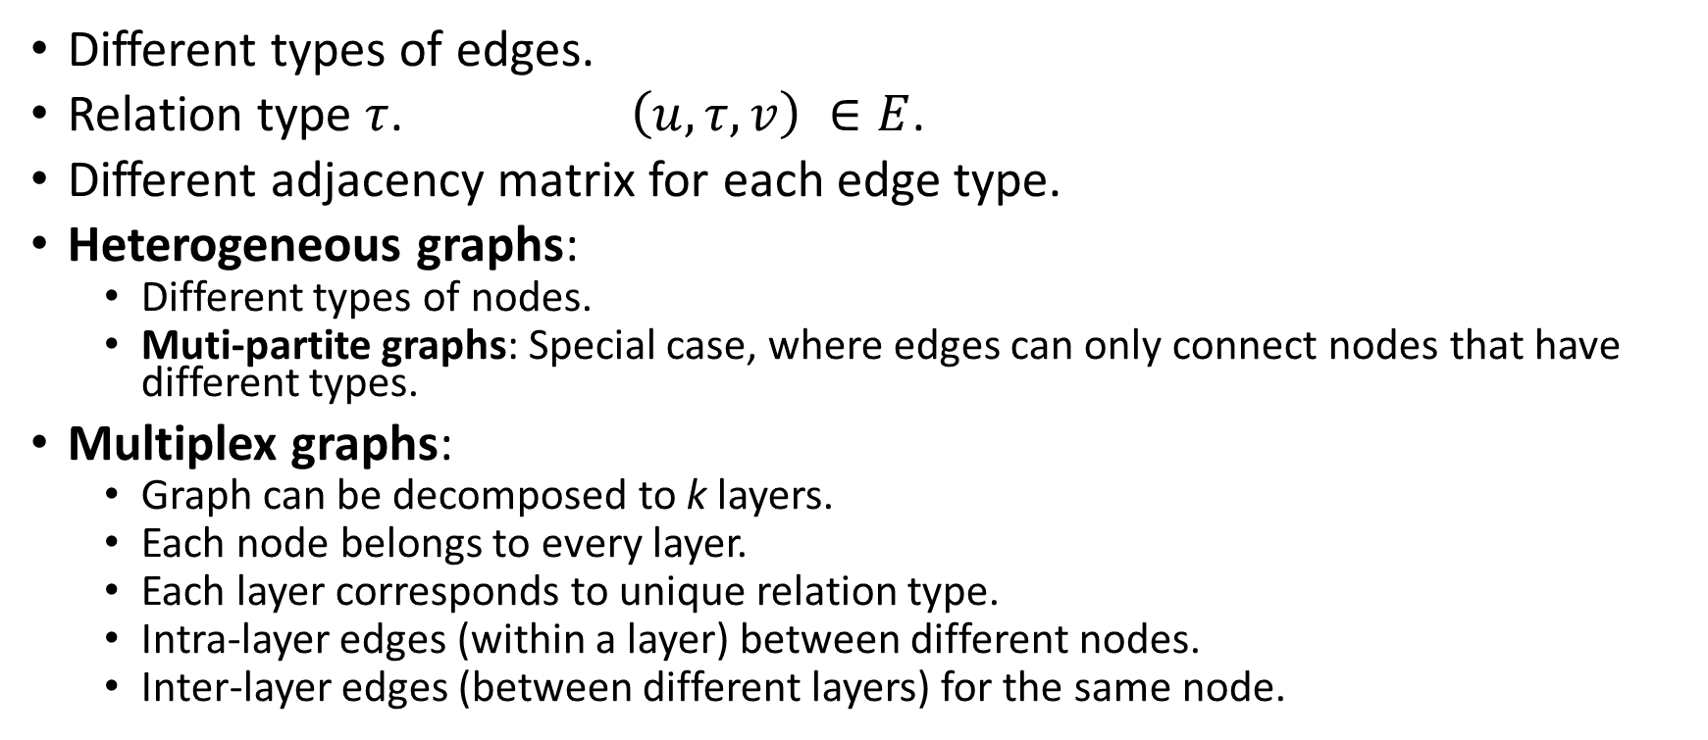
Multi-relational graphs
Different types of edges.
Relation type $τ$. $\left(u, τ, v\right) ∈E$.
Different adjacency matrix for each edge type.
Heterogeneous graphs:
Different types of nodes.
Muti-partite graphs: Special case, where edges can only connect nodes that have different types.
Multiplex graphs:
Graph can be decomposed to k layers.
Each node belongs to every layer.
Each layer corresponds to unique relation type.
Intra-layer edges (within a layer) between different nodes.
Inter-layer edges (between different layers) for the same node.

Slide 6

Attributes or features
Nodes and / or edges can have additional data in attributes or features.
Node-level attributes represented in real-valued matrix $X ∈ ℝ^{\left|V\right| ×m}$ where V is number of nodes and m is number of attributes.

Slide 7
Nomenclature
“Graph”:
Term preferred by machine learning community.
Abstract data structure.
“Network”:
Term preferred by data mining and network science communities.
Specific, real-world instantiations of this data structure (e.g., social networks).

Slide 8
Machine learning on graphs
(1) Node classification (semi-supervised):
Given: all data of all edges, and all data of some nodes (training set).
Predict: data of remaining nodes (test set).
Examples:
Classify social network nodes as humans (users) or computer programs (bots),
classifying proteins’ function,
classifying documents’ topics based on hyperlink or citation graphs, etc.
Difference from standard supervised classification: nodes in a graph are not independent and identically distributed (IID).
Explicitly leverage connections between nodes:
Homophily: tendency for nodes to share attributes with their neighbors in the graph.
Structural equivalence: nodes with similar local neighborhood structures will have similar labels.
Heterophily: nodes will be preferentially connected to nodes with different labels.

Slide 9
Machine learning on graphs (continued)
(2) Relation prediction (semi-supervised):
Given: all data of all nodes, and all data of some edges (training set).
Predict: remaining edges and their data (test set).
Complexity depends on type of graph data.
Examples:
recommending content to users in social platforms,
predicting drug side-effects,
inferring new facts in a relational databases, etc.

Slide 10
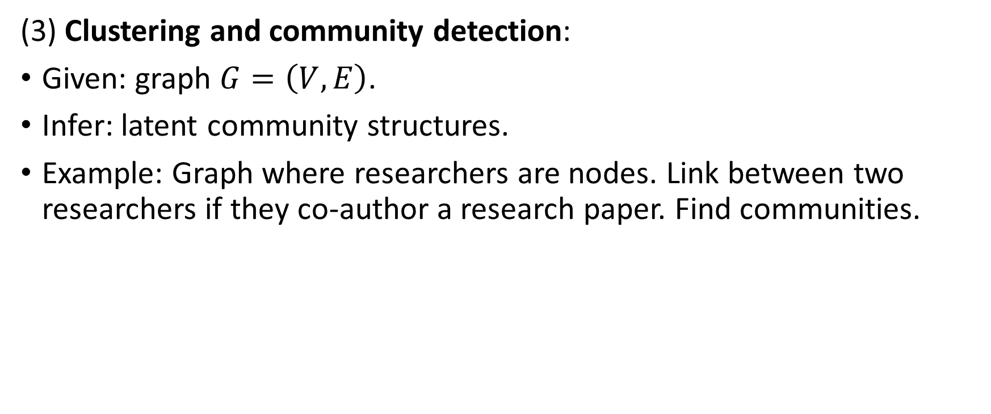
Machine learning on graphs (continued)
(3) Clustering and community detection:
Given: graph $G=\left(V, E\right)$.
Infer: latent community structures.
Example: Graph where researchers are nodes. Link between two researchers if they co-author a research paper. Find communities.

Slide 11
Machine learning on graphs (continued)
(4) Graph classification, regression, and clustering:
Perform task on multiple entire graphs.
Embeddings about nodes, edges, graphs, etc.
Examples:
Graphs representing molecules’ structures: regression to predict molecules’ toxicity or solubility.
Graphs representing programs’ syntax and data flow: classify programs as malicious or not.
Make independent predictions specific to each graph.
Each graph is independent and identically distributed data point.
Graph clustering: learn an unsupervised measure of similarity between pairs of graphs.
Challenge: Defining useful features that take into account the relational structure within each graph.

Slide 12
Chapter 2: Background and Traditional Approaches

Slide 13
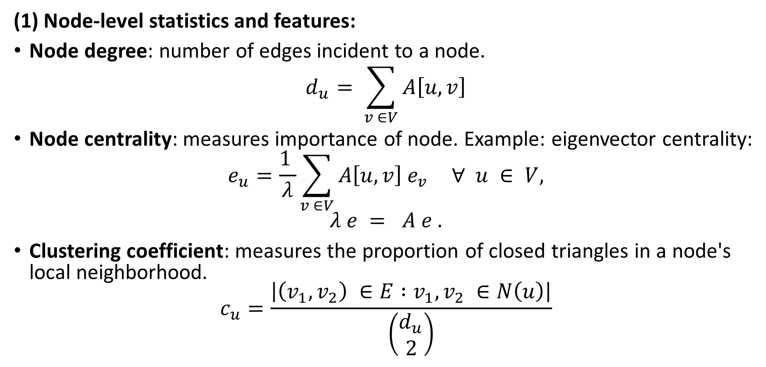
Graph Statistics and Kernel Methods
(1) Node-level statistics and features:
Node degree: number of edges incident to a node.
$$d_{u}= \sum_{v ∈V}{A\left[u, v\right]}$$
Node centrality: measures importance of node. Example: eigenvector centrality:
$$e_{u}=\frac{1 }{λ}\sum_{v ∈V}{A\left[u, v\right] e_{v}} ∀ u ∈ V,$$
$$λ e = A e .$$
Clustering coefficient: measures the proportion of closed triangles in a node's local neighborhood.
$$c_{u}=\frac{\left|\left(v_{1}, v_{2}\right) ∈E :v_{1}, v_{2} ∈N\left(u\right)\right|}{\left(\begin{matrix}d_{u} \\ 2\end{matrix}\right)}$$

Slide 14
Graph Statistics and Kernel Methods (continued)
Closed triangles, ego graphs, and motifs:
Ego graph of a node: subgraph containing that node, its neighbors, and all the edges between nodes in its neighborhood. (include figure)
Motifs or graphlets within a node's ego graph: rather than just counting triangles, we could consider more complex structures, such as cycles of particular length. We could characterize nodes by counts of how often these different motifs occur in their ego graph. (include figure)

Slide 15
Graph Statistics and Kernel Methods (continued)
(2) Graph-level features and graph kernels:
Bag of nodes:
Aggregate of node-level statistics, used as a graph-level representation.
Algorithm is independent of node ordering.
Disadvantage: entirely based upon local node-level information. May miss important global properties in the graph.
Weisfeiler-Lehman kernel:
Iterative neighborhood aggregation: Extract node-level features that contain more information than just their local ego graph. Aggregate these richer features into a graph-level representation.

Slide 16
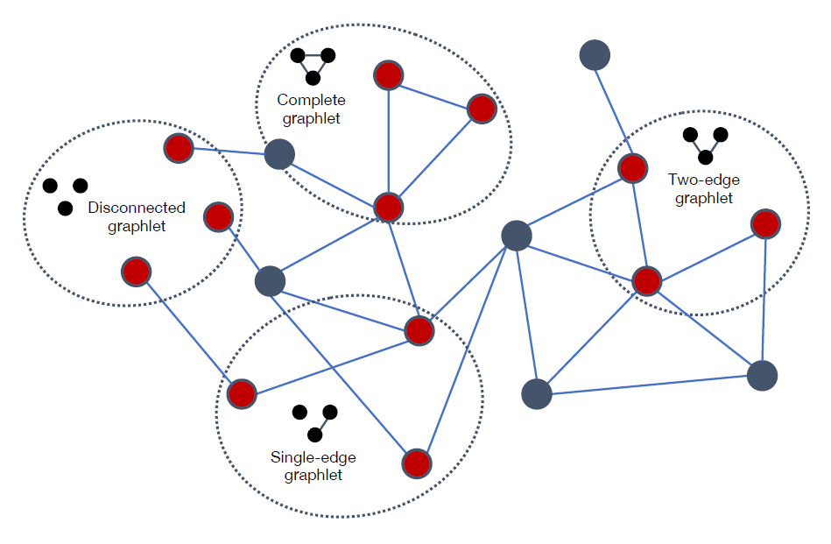
Graph Statistics and Kernel Methods (continued)
Graphlets and path-based methods:
Graphlets: small subgraph structures. Challenge: counting these is a combinatorically difficult problem.
Path-based methods: Examine different kinds of paths that occur in a graph.
Describe kernel methods of graphs. Check blogs,
Figure 2.2: The four different size-3 graphlets that can occur in a simple graph.

Slide 17
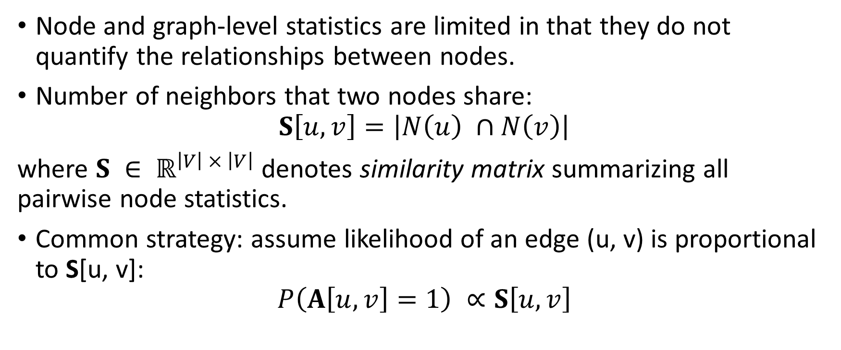
Neighborhood Overlap Detection
Node and graph-level statistics are limited in that they do not quantify the relationships between nodes.
Number of neighbors that two nodes share:
$$S\left[u, v\right]=\left|N\left(u\right) ∩N\left(v\right)\right|$$
where $S ∈ ℝ^{\left|V\right| × \left|V\right|}$ denotes similarity matrix summarizing all pairwise node statistics.
Common strategy: assume likelihood of an edge (u, v) is proportional to S[u, v]:
$$P\left(A\left[u, v\right]=1\right) ∝S\left[u, v\right]$$

Slide 18
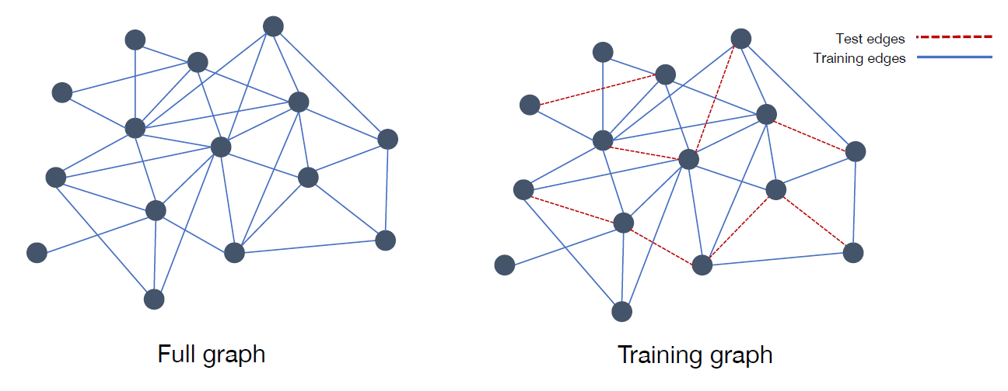
Full graph and a subsampled graph used for training.
Dotted edges in training graph are removed when training a model or computing overlap statistics.
Model is evaluated based on its ability to predict existence of these held-out test edges.

Slide 19
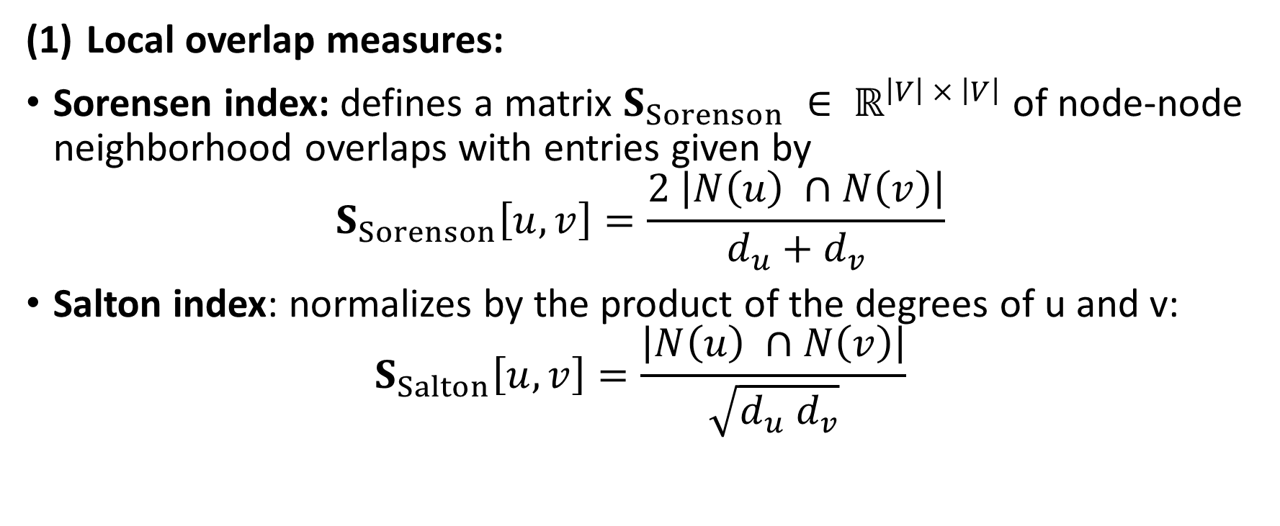
Neighborhood Overlap Detection (continued)
Local overlap measures:
Sorensen index: defines a matrix $S_{Sorenson} ∈ ℝ^{\left|V\right| × \left|V\right|}$ of node-node neighborhood overlaps with entries given by
$$S_{Sorenson}\left[u, v\right]=\frac{2 \left|N\left(u\right) ∩N\left(v\right)\right|}{d_{u}+d_{v}}$$
Salton index: normalizes by the product of the degrees of u and v:
$$S_{Salton}\left[u, v\right]=\frac{\left|N\left(u\right) ∩N\left(v\right)\right|}{\sqrt{d_{u} d_{v}}}$$
Notes:
Number of common neighbors divided by average degree.

Slide 20
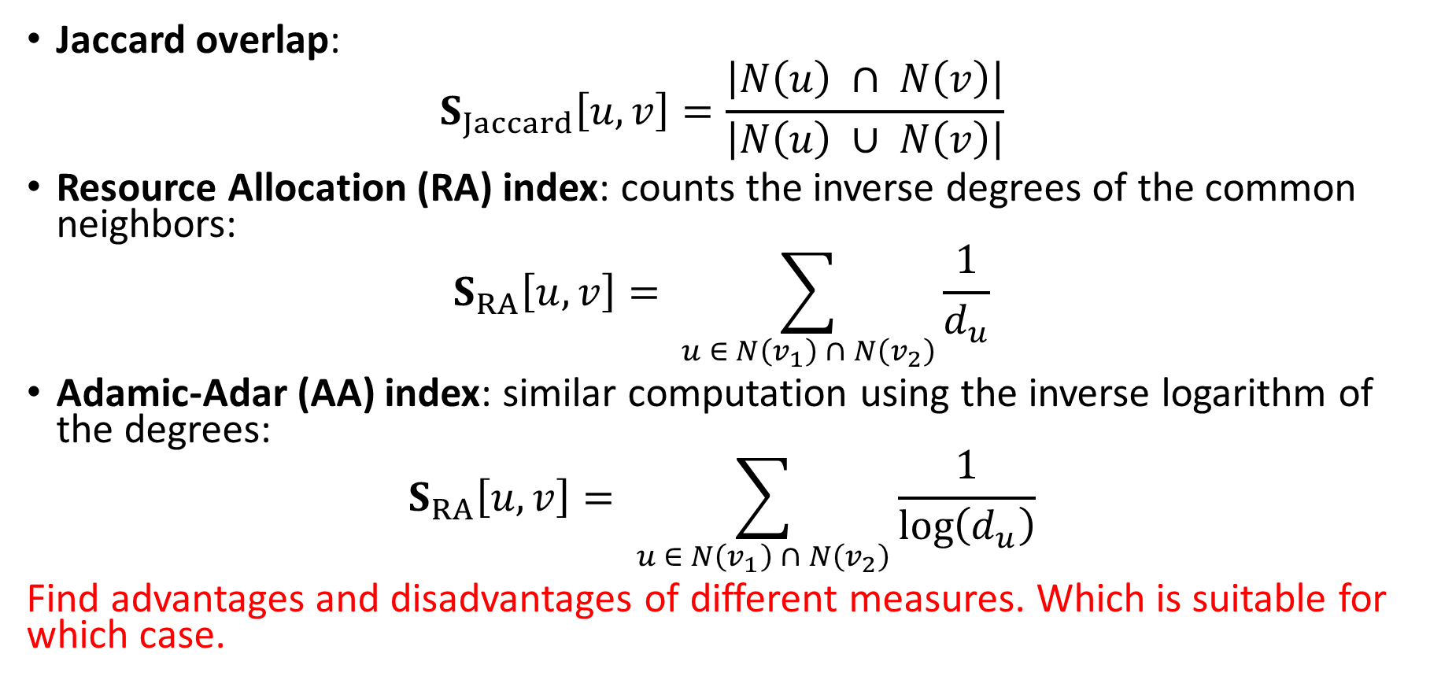
Neighborhood Overlap Detection (continued)
Jaccard overlap:
$$S_{Jaccard}\left[u, v\right]=\frac{\left|N\left(u\right) ∩ N\left(v\right)\right|}{\left|N\left(u\right) ∪ N\left(v\right)\right|}$$
Resource Allocation (RA) index: counts the inverse degrees of the common neighbors:
$$S_{RA}\left[u, v\right]= \sum_{u ∈ N\left(v_{1}\right) ∩ N\left(v_{2}\right)}{\frac{1}{d_{u}}}$$
Adamic-Adar (AA) index: similar computation using the inverse logarithm of the degrees:
$$S_{RA}\left[u, v\right]= \sum_{u ∈ N\left(v_{1}\right) ∩ N\left(v_{2}\right)}{\frac{1}{\log\left(d_{u}\right)}}$$
Find advantages and disadvantages of different measures. Which is suitable for which case.

Slide 21
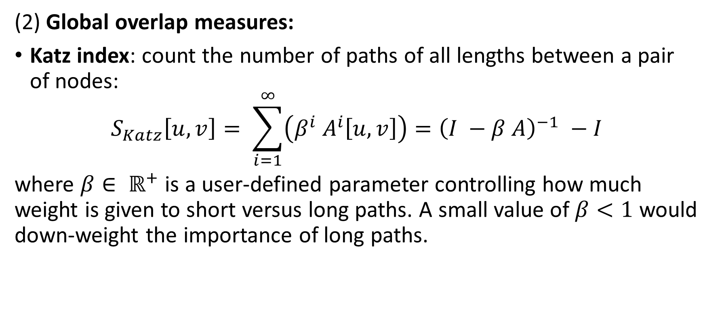
Neighborhood Overlap Detection (continued)
(2) Global overlap measures:
Katz index: count the number of paths of all lengths between a pair of nodes:
$$S_{Katz}\left[u, v\right]= \sum_{i=1}^{∞}{\left(β^{i} A^{i}\left[u, v\right]\right)}={\left(I −β A\right)}^{−1} −I$$
where $β∈ ℝ^{+}$ is a user-defined parameter controlling how much weight is given to short versus long paths. A small value of $β<1$ would down-weight the importance of long paths.

Slide 22
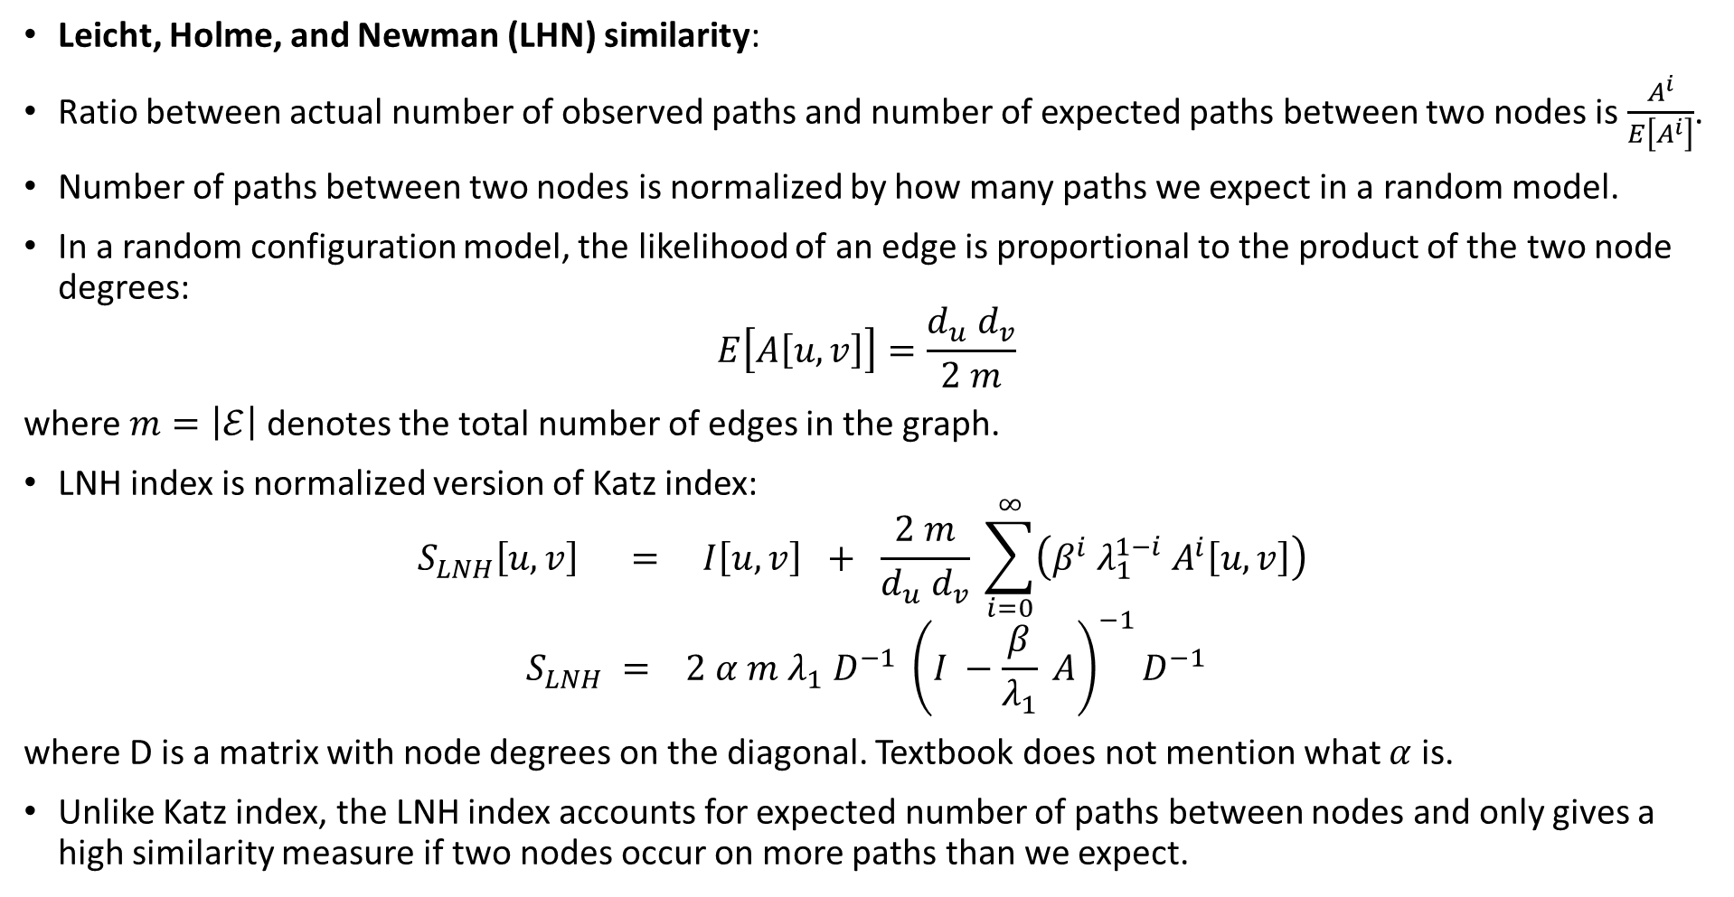
Neighborhood Overlap Detection (continued)
Leicht, Holme, and Newman (LHN) similarity:
Ratio between actual number of observed paths and number of expected paths between two nodes is $\frac{A^{i}}{E\left[A^{i}\right]}$.
Number of paths between two nodes is normalized by how many paths we expect in a random model.
In a random configuration model, the likelihood of an edge is proportional to the product of the two node degrees:
$$E\left[A\left[u, v\right]\right]=\frac{d_{u} d_{v}}{2 m}$$
where $m=\left|ℰ\right|$ denotes the total number of edges in the graph.
LNH index is normalized version of Katz index:
$$S_{LNH}\left[u, v\right] = I\left[u, v\right] + \frac{2 m}{d_{u} d_{v}} \sum_{i=0}^{∞}{\left(β^{i} λ_{1}^{1−i} A^{i}\left[u, v\right]\right)}$$
$$S_{LNH} = 2 α m λ_{1} D^{−1} {\left(I −\frac{β}{λ_{1}} A\right)}^{−1}D^{−1}$$
where D is a matrix with node degrees on the diagonal. Textbook does not mention what $α$ is.
Unlike Katz index, the LNH index accounts for expected number of paths between nodes and only gives a high similarity measure if two nodes occur on more paths than we expect.

Slide 23
Chapter 3: Neighborhood Reconstruction Methods

Slide 24
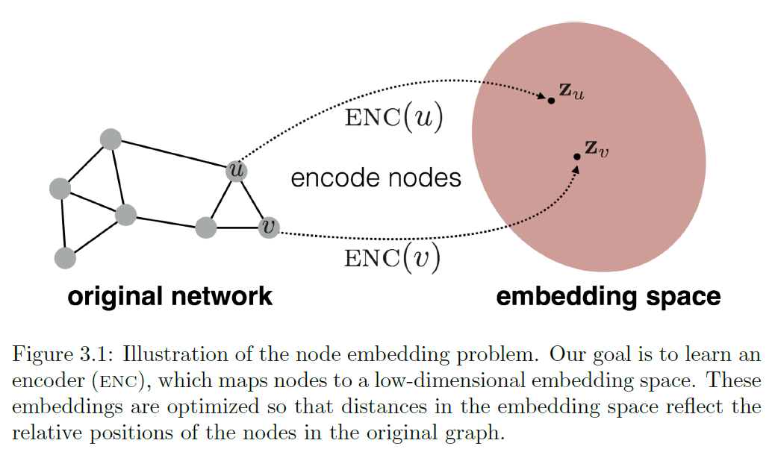
Methods for learning node embeddings.
Encode nodes as low-dimensional vectors that summarize their graph position and the structure of their local graph neighborhood.

Slide 25
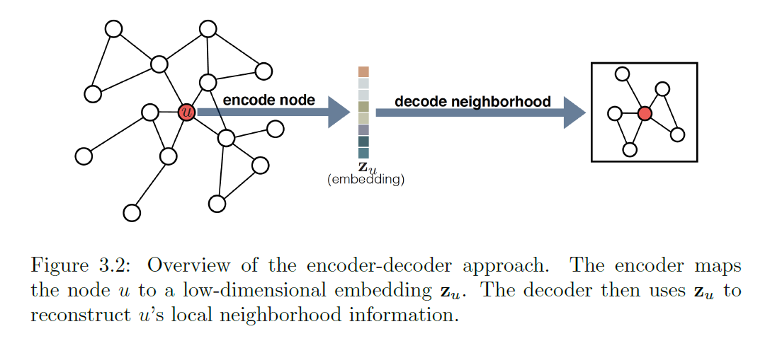
Encoder-Decoder Perspective
Encoder model maps each node in the graph into a low-dimensional vector or embedding.
Decoder model takes the low-dimensional node embeddings and uses them to reconstruct information about each node's neighborhood in the original graph.

Slide 26
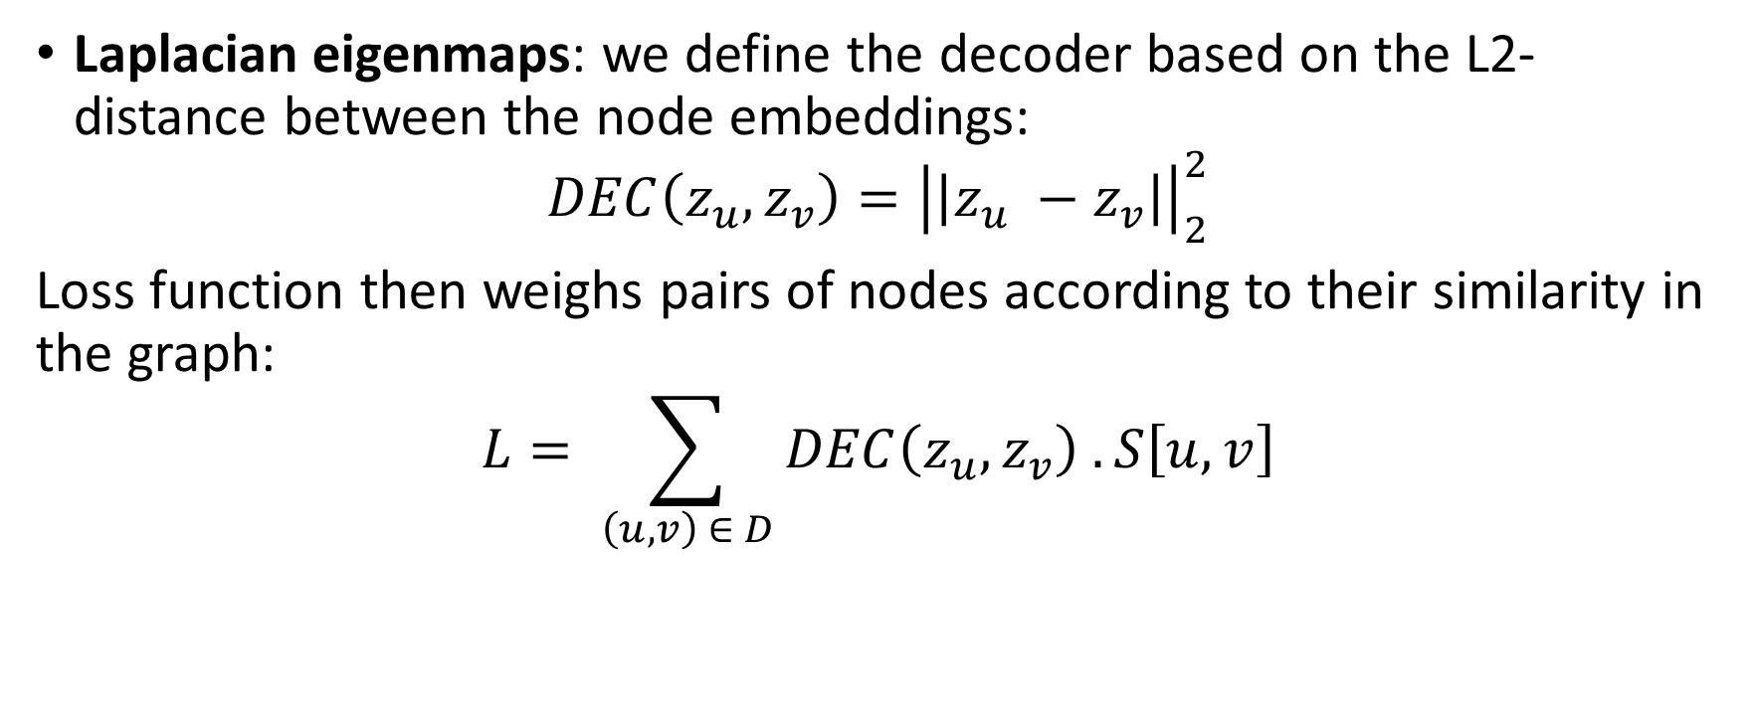
Factorization-based approaches
Laplacian eigenmaps: we define the decoder based on the L2-distance between the node embeddings:
$$DEC\left(z_{u}, z_{v}\right)={\left|\left|z_{u} −z_{v}\right|\right|}_{2}^{2}$$
Loss function then weighs pairs of nodes according to their similarity in the graph:
$$L= \sum_{\left(u, v\right) ∈ D}{DEC\left(z_{u}, z_{v}\right) . S\left[u, v\right]}$$

Slide 27
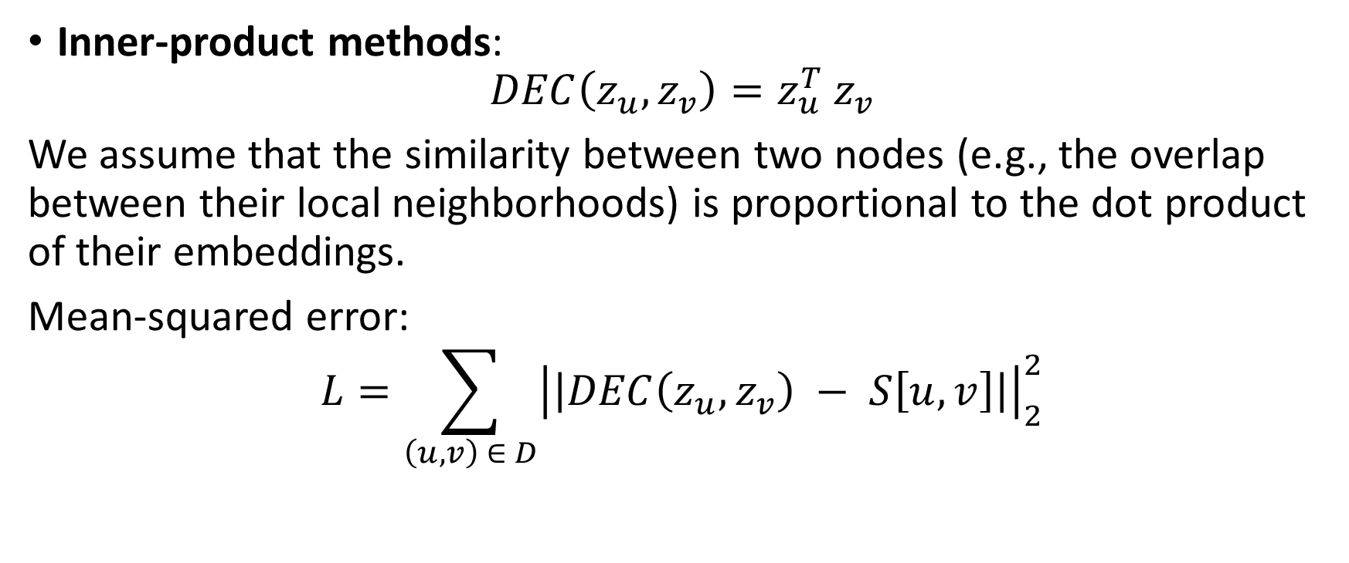
Factorization-based approaches (continued)
Inner-product methods:
$$DEC\left(z_{u}, z_{v}\right)=z_{u}^{T} z_{v}$$
We assume that the similarity between two nodes (e.g., the overlap between their local neighborhoods) is proportional to the dot product of their embeddings.
Mean-squared error:
$$L=\sum_{\left(u, v\right) ∈ D}{{\left|\left|DEC\left(z_{u}, z_{v}\right) − S\left[u, v\right]\right|\right|}_{2}^{2}}$$

